Slide 1


Basic details of the Team and Project Idea
Title : Open Innovation
Team : Team Coders
Team Leader : Harpreet Singh
Institute : Baba Farid College Of Engineering &
Technology, Bathinda.
Theme : Bharat Bharaman

Slide 2
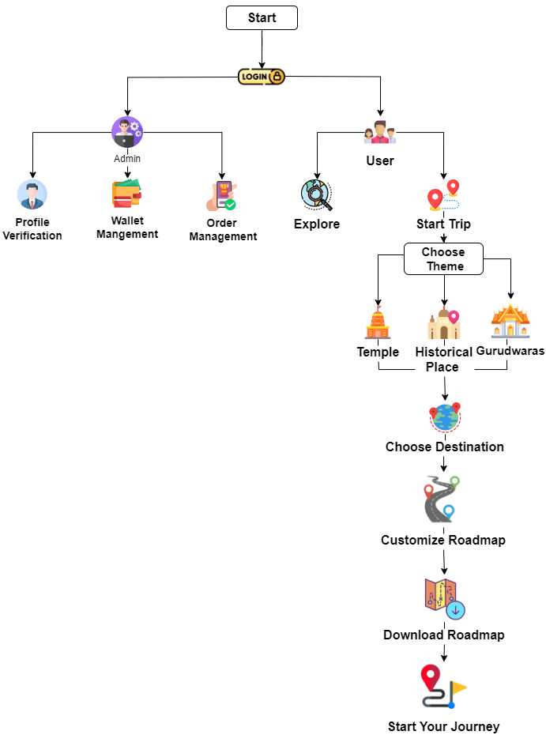












Idea/Approach Details
We're looking for a solution to promote the tourism sector of Bharat by creating a web based application which will provide a full fledged roadmap to a tourist and make his/her experience seamless and create a global impact to bring more tourists from all over the globe to Bharat by educating and spreading knowledge about the historical sites, temples & other landscapes.
The prototype will work as follow :
Identification of new places and other famous sites will promote education and tourism sector of Bharat.
Hotels and food points will upraise their revenue by attracting more tourists by running attractive offers whereas making tourists stay safe and comfortable.
Famous holy places around the destinations will also be covered.
Economy crisis for small scale intvesters will come to an end as it will crater them financial growth and open doors for many opportunities.
Promotion of india’s rich history will attract many tourists.
Technology used

Slide 3

Idea/Approach Details
Use Cases:
Dependencies / Show stopper:
Travellers can benefit from this app by saving their time and energy.
This app will not only provide our travellers detailed information of their destination but also provide them with information about how much they are willing to spend on a particular destination.
Our team has also focused on the economy class people as they, too, will get the opportunity to grow their business.
The travellers have free access to this app.
The app also has an objective of providing off-line guides to customers who are out of network range.
Tourist is all set to visit the new Bharat
Automating & integrating AI to choose the shortest path and make the best outcome of the corresponding inputs.
⮚ Collecting and managing a large enormous database.
⮚ Making available only best and value for money
accommodation & food.
⮚ Bringing small creators, pot makers & roadside food
vendors etc. on the web page.
⮚ Arranging offline guide where no online mode works.
⮚ Integrating & training a Chabot to answer all the queries of
tourist and make their experience more efficient and
memorable.

Slide 4
Team Member Details
Team Leader Name: Harpreet Singh
Branch : B.Tech Stream : CSE Year : III
Team Member 1 Name: Ajay Godara
Branch : B.Tech Stream : CSE Year : III
Team Member 2 Name: Kamalveer Kaur
Branch : B.Tech Stream : CSE Year : III
Team Member 3 Name : Anshika Goyal
Branch : B.Tech Stream : CSE Year: III
Team Mentor Name: Er. Amritpal Kaur
Category : Academic Expertise : AI/ML Domain Experience : 3+ Years

